Slide 1
Function Pointer
In C/C++, functions, like all data items, have an address.
The name of a function is the starting address where the function resides in the memory, and therefore, can be treated as a pointer.
We can pass a function pointer into function as well. The syntax for declaring a function pointer is:
// Function-pointer declaration
return-type (* function-ptr-name) (parameter-list)
// Examples
double (*fp)(int, int) // fp points to a function that takes two ints and returns a double (function-pointer)
double *dp; // dp points to a double (double-pointer)
double *fun(int, int) // fun is a function that takes two ints and returns a double-pointer
double f(int, int); // f is a function that takes two ints and returns a double
fp = f; // Assign function f to fp function-pointer

Slide 2
/* Test Function Pointers (TestFunctionPointer.cpp) */
#include <iostream>
using namespace std;
int arithmetic(int, int, int (*)(int, int));
// Take 3 arguments, 2 int's and a function pointer // int (*)(int, int), which takes two int's and return an int
int add(int, int);
int sub(int, int);
int add(int n1, int n2) { return n1 + n2; }
int sub(int n1, int n2) { return n1 - n2; }
int arithmetic(int n1, int n2, int (*operation) (int, int)) {
return (*operation)(n1, n2);
}
int main() {
int number1 = 5, number2 = 6;
// add
cout << arithmetic(number1, number2, add) << endl;
// subtract
cout << arithmetic(number1, number2, sub) << endl;
}

Slide 3
Generic Pointer or void Pointer (void *)
A void pointer can hold address of any data type (except function pointer).
We cannot operate on the object pointed to by void pointer, as the type is unknown.
We can use a void pointer to compare with another address.

Slide 4
Constant Pointer vs. Constant Pointed-to Data
Non-constant pointer to non-constant data: Data pointed to CAN be changed; and pointer CAN be changed to point to another data. For example,
int i1 = 8, i2 = 9;
int * iptr = &i1; // non-constant pointer pointing to non-constant data
*iptr = 9; // okay
iptr = &i2; // okay
Non-constant pointer to constant data: Data pointed to CANNOT be changed; but pointer CAN be changed to point to another data. For example,
int i1 = 8, i2 = 9;
const int * iptr = &i1; // non-constant pointer pointing to constant data
// *iptr = 9; // error: assignment of read-only location
iptr = &i2; // okay

Slide 5
Constant pointer to non-constant data: Data pointed to CAN be changed; but pointer CANNOT be changed to point to another data. For example,
int i1 = 8, i2 = 9;
int * const iptr = &i1; // constant pointer pointing to non-constant data // constant pointer must be initialized during declaration
*iptr = 9; // okay
// iptr = &i2; // error: assignment of read-only variable
Constant pointer to constant data: Data pointed to CANNOT be changed; and pointer CANNOT be changed to point to another data. For example,
int i1 = 8, i2 = 9;
const int * const iptr = &i1; // constant pointer pointing to constant data
// *iptr = 9; // error: assignment of read-only variable
// iptr = &i2; // error: assignment of read-only variable

Slide 6
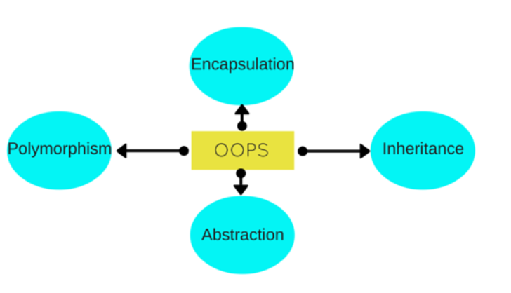

Slide 7
Suppose there are 3 sections in the 12th grade of your school: A, B, and C.
The functions that we need to perform in each class are taking the attendance, distributing newspapers to students who subscribed for it, and giving them their final grades.

Slide 8
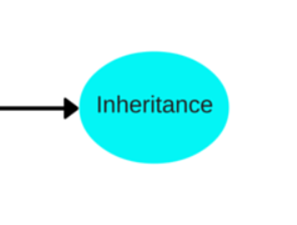

Slide 9
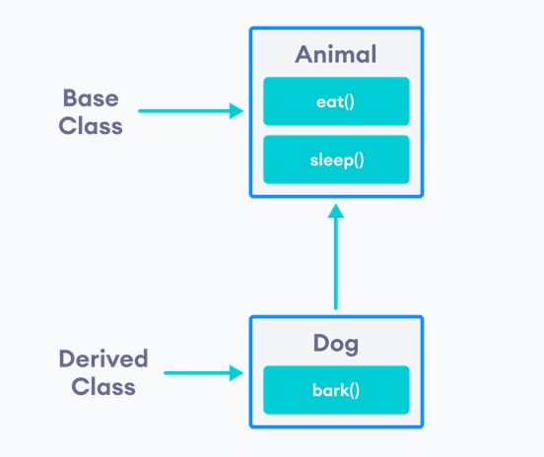

Slide 10
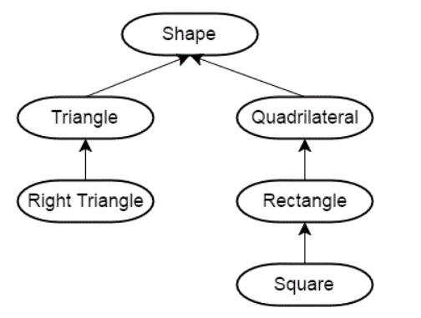

Slide 11
It drastically reduces code redundancy as it allows the derived class to inherit all the properties of the base class, leaving no room for duplicate data to achieve the same task.
Inheritance in C++ offers the feature of code reusability. We can use the same fragment of code multiple times.
To sum it up, inheritance helps us save our development time, maintain data in a simplified manner and gives us the provision to make our code extensible.
It increases the code reliability by providing a definite body to the program.

Slide 12
The capability of a class to derive properties and characteristics from another class is called Inheritance.
Sub Class:
The class that inherits properties from another class is called Sub class or Derived Class.
Super Class:
The class whose properties are inherited by sub class is called Base Class or Super class.

Slide 13
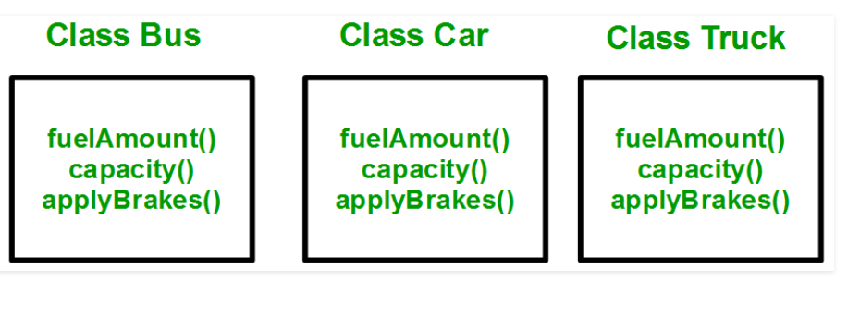

Slide 14
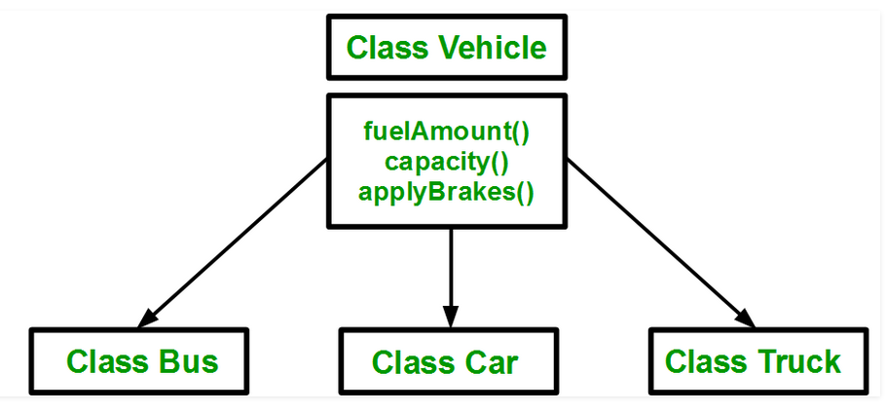

Slide 15
Using inheritance,
we have to write the functions only one time instead of three times as we have inherited rest of the three classes from base class(Vehicle).
Implementing inheritance in C++:
For creating a sub-class which is inherited from the base class we have to follow the below syntax.
class subclass_name : access_mode base_class_name
{
//body of subclass
};
subclass_name is the name of the sub class,
access_mode is the mode in which you want to inherit this sub class for example: public, private etc.
base_class_name is the name of the base class from which you want to inherit the sub class.
A derived class doesn’t inherit access to private data members. However, it does inherit a full parent object, which contains any private members which that class declares

Slide 16
// C++ program to demonstrate implementation // of Inheritance
#include <iostream>
using namespace std;
//Base class
class Parent
{
public:
int id_p;
};
// Sub class inheriting from Base Class(Parent)
class Child : public Parent
{
public:
int id_c;
};
int main()
{
Child obj1;
// An object of class child has all data members
// and member functions of class parent
obj1.id_c = 7;
obj1.id_p = 91;
cout << "Child id is " << obj1.id_c << endl;
cout << "Parent id is " << obj1.id_p << endl;
return 0;
}

Slide 17
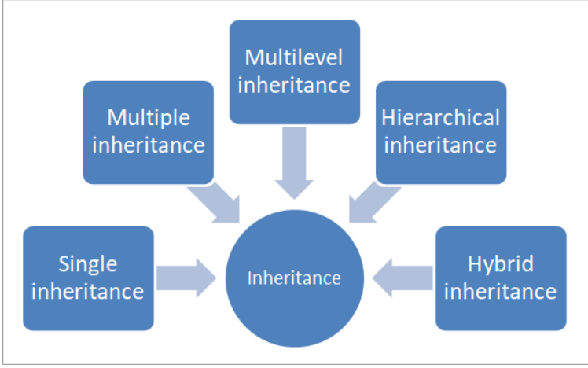

Slide 18
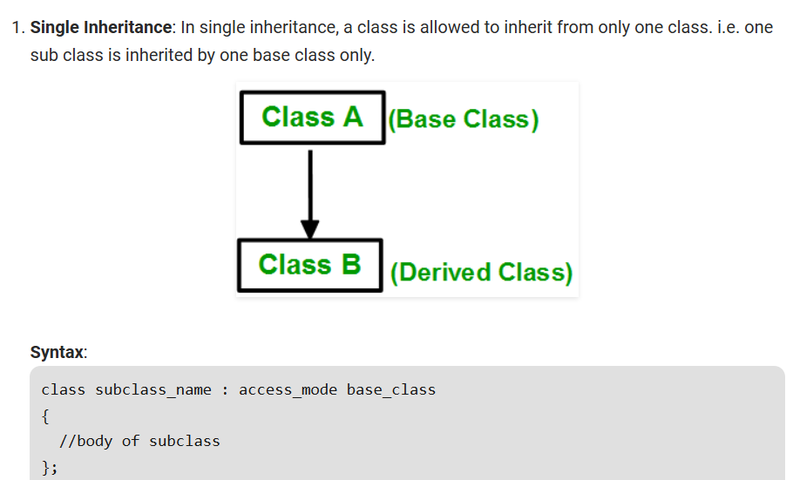

Slide 19

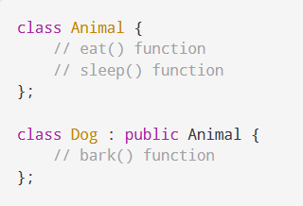

Slide 20
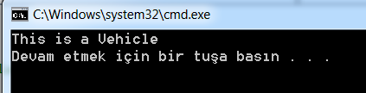
// C++ program to explain // Single inheritance
#include <iostream>
using namespace std;
class Vehicle { // base class
public:
Vehicle() {
cout << "This is a Vehicle" << endl;
}
};
class Car: public Vehicle{ // sub class derived from two base classes
};
int main() {
// creating object of sub class will // invoke the constructor of base classes
Car obj;
return 0;
}

Slide 21
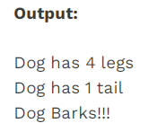
#include <iostream>
#include <string>
using namespace std;
class Animal{
string name="";
public:
int tail=1;
int legs=4;
};
class Dog : public Animal{
public:
void voiceAction() {
cout<<"Barks!!!";
}
};
int main(){
Dog dog;
cout<<"Dog has "<<dog.legs<<" legs"<<endl;
cout<<"Dog has "<<dog.tail<<" tail"<<endl;
cout<<"Dog ";
dog.voiceAction();
}

Slide 22
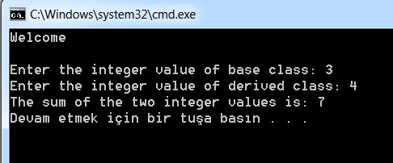
class Base{
public:
int base_value;
void base_input(){
cout<<"Enter the integer value of base class: ";
cin>>base_value;
}
};
class Derived : public Base {
int derived_value; // private by default
public:
void derived_input(){
cout<<"Enter the integer value of derived class: ";
cin>>derived_value;
}
void sum(){
cout << "The sum of the two integer values is: " << base_value + derived_value<<endl;
}
};
int main(){
cout<<"Welcome "<<endl<<endl;
Derived d; // Object of the derived class
d.base_input();
d.derived_input();
d.sum();
return 0;
}

Slide 23

#include <iostream>
using namespace std;
// Base class
class Shape {
public:
void setWidth(int w) {
width = w;
}
void setHeight(int h) {
height = h;
}
protected:
int width;
int height;
};
// Derived class
class Rectangle: public Shape {
public:
int getArea() {
return (width * height);
}
};
int main(void) {
Rectangle Rect;
Rect.setWidth(5);
Rect.setHeight(7);
// Print the area of the object.
cout << "Total area: " << Rect.getArea() << endl;
return 0;
}

Slide 24
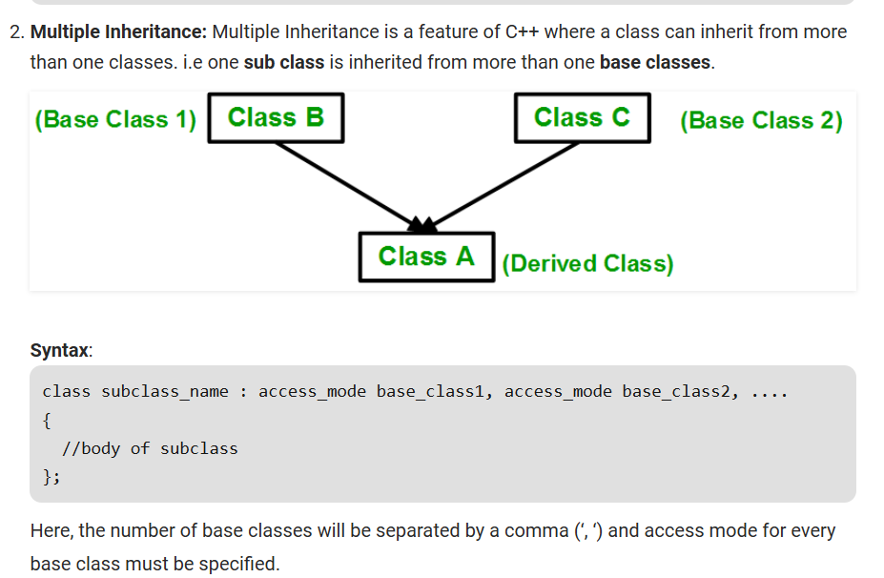

Slide 25
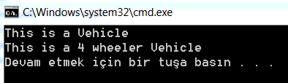
#include <iostream> using namespace std;
class Vehicle { // first base class
public:
Vehicle() {
cout << "This is a Vehicle" << endl;
}
};
class FourWheeler { // second base class
public:
FourWheeler() {
cout << "This is a 4 wheeler Vehicle" << endl;
}
};
class Car: public Vehicle, public FourWheeler { // sub class derived from two base classes
};
int main() {
// creating object of sub class will // invoke the constructor of base classes
Car obj;
return 0;
}
// C++ program to explain // multiple inheritance

Slide 26
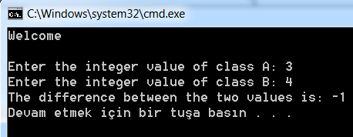
class A{
public:
int A_value;
void A_input(){
cout<<"Enter the integer value of class A: ";
cin>>A_value;
}
};
class B{
public:
int B_value;
void B_input(){
cout<<"Enter the integer value of class B: ";
cin>>B_value;
}
};
class C : public A, public B{
//C is a derived class from classes A and B
public:
void difference(){
cout<<"The difference between the two values is: " << A_value - B_value<<endl;
}
};
int main()
{
cout<<"Welcome"<<endl<<endl;
C c; // c is an Object of derived class C
c.A_input();
c.B_input();
c.difference();
return 0;
}

Slide 27
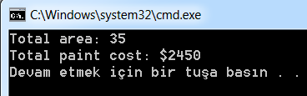
#include <iostream>
using namespace std;
class Shape { // Base class Shape
public:
void setWidth(int w) {
width = w;
}
void setHeight(int h) {
height = h;
}
protected:
int width;
int height;
};
class PaintCost { // Base class PaintCost
public:
int getCost(int area) {
return area * 70;
}
};
class Rectangle: public Shape, public PaintCost { // Derived class
public:
int getArea() {
return (width * height);
}
};
int main(void) {
Rectangle Rect;
int area;
Rect.setWidth(5);
Rect.setHeight(7);
area = Rect.getArea();
// Print the area of the object.
cout << "Total area: " << Rect.getArea() << endl;
// Print the total cost of painting
cout << "Total paint cost: $" << Rect.getCost(area) << endl;
return 0;
}

Slide 28
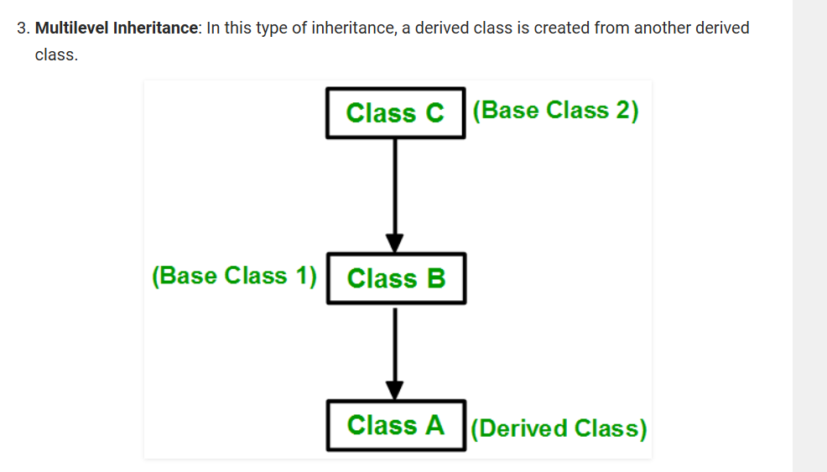

Slide 29
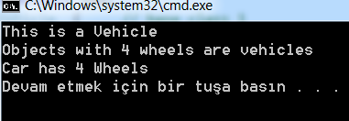
#include <iostream> using namespace std;
class Vehicle { // base class 1
public:
Vehicle() {
cout << "This is a Vehicle" << endl;
}
};
class fourWheeler: public Vehicle {// base class 2
public:
fourWheeler() {cout<<"Objects with 4 wheels are vehicles"<<endl;
}
};
class Car: public fourWheeler{ // sub class derived from two base classes
public:
Car() {
cout<<"Car has 4 Wheels"<<endl;
}
};
// C++ program to implement
// Multilevel Inheritance
int main() {
//creating object of sub class will
//invoke the constructor of base classes
Car obj;
return 0;
}

Slide 30
class Base{
public:
int base_value;
void Base_input(){
cout<<"Enter the integer value of base class: ";
cin>>base_value;
}
};
class Derived1 : public Base{ // Derived class of //base class
public:
int derived1_value;
void Derived1_input(){
cout<<"Enter the integer value of first derived class: ";
cin>>derived1_value;
}
};
class Derived2 : public Derived1{ // Derived class of //Derived1 class
int derived2_value;
public:
void Derived2_input(){
cout<<"Enter the integer value of the second derived class: ";
cin>>derived2_value;
}
void sum(){
cout << "The sum of the three intger : " << base_value + derived1_value + derived2_value<<endl;
}
};
int main(){
cout<<"Welcome "<<endl<<endl;
Derived2 d2; // Object d2 of second derived class
d2.Base_input();
d2.Derived1_input();
d2.Derived2_input();
d2.sum();
return 0;
}

Slide 31
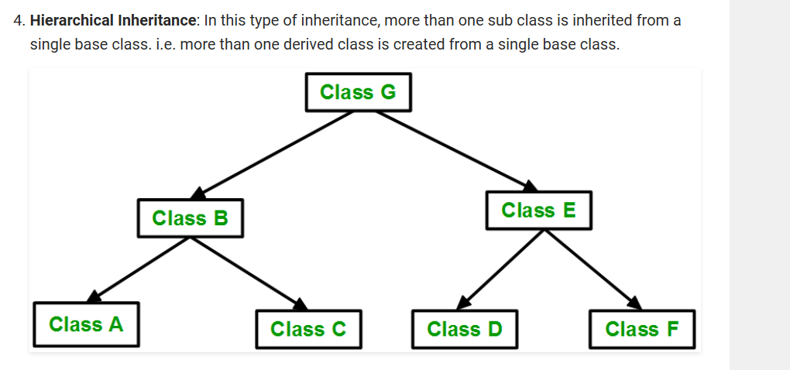

Slide 32
#include <iostream>
using namespace std;
class Vehicle { // base class
public:
Vehicle() {
cout << "This is a Vehicle" << endl;
}
};
class Car: public Vehicle { // first sub class
};
class Bus: public Vehicle { // second sub class
};
int main() {
// creating object of sub class will // invoke the constructor of base class
Car obj1;
Bus obj2;
return 0;
}
// C++ program to implement // Hierarchical Inheritance

Slide 33
class A {
public:
int x, y;
void A_input(){
cout<<"Enter two values of class A: ";
cin>>x>>y;
}
};
class B : public A { // B is derived from A
public:
void product(){
cout<<"The Product of the two values is: "<< x * y<<endl;
}
};
class C : public A{ //C is derived from A
public:
void division(){
cout<<"The Division of the two values is: "<< x / y<<endl;
}
};
int main(){
cout<<"Welcome"<<endl<<endl;
B b; // Object b of derived class B
C c; // Object c of derived class C
b.A_input();
b.product();
c.A_input();
c.division();
return 0;
}

Slide 34
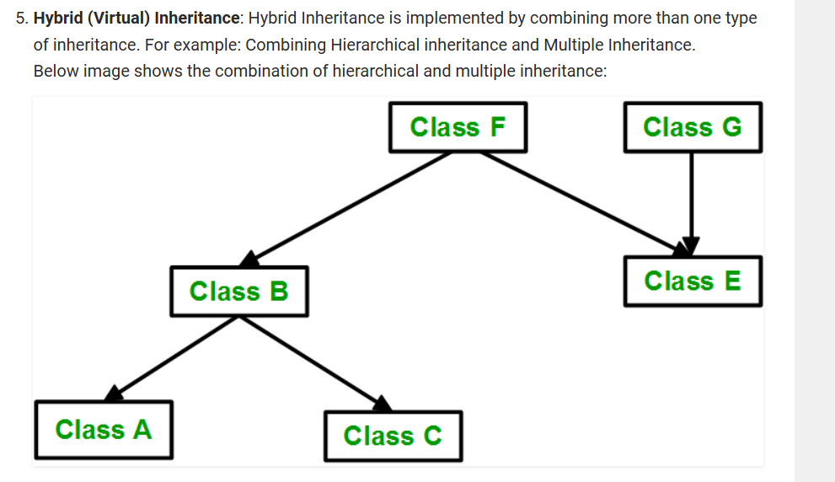

Slide 35
#include <iostream> using namespace std;
class Vehicle { // base class
public:
Vehicle() {
cout << "This is a Vehicle" << endl;
}
};
class Fare { //base class
public:
Fare() {
cout<<"Fare of Vehicle\n";
}
};
class Car: public Vehicle { // first sub class
};
class Bus: public Vehicle, public Fare { // second sub class
};
// C++ program for Hybrid Inheritance
int main()
{
// creating object of sub class will
// invoke the constructor of base class
Bus obj2;
return 0;
}

Slide 36
#include<iostream>
using namespace std;
class A {
public:
A() { cout << "A's constructor called" << endl; }
};
class B {
public:
B() { cout << "B's constructor called" << endl; }
};
class C: public B, public A { // Note the order
public:
C() { cout << "C's constructor called" << endl; }
};
int main() {
C c;
return 0;
}
Output:
B's constructor called
A's constructor called
C's constructor called

Slide 37
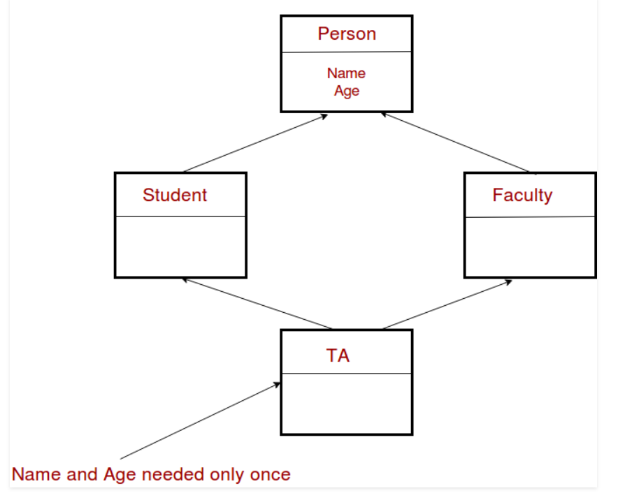
The diamond problem The diamond problem occurs when two superclasses of a class have a common base class. For example, in the following diagram, the TA class gets two copies of all attributes of Person class, this causes ambiguities.

Slide 38
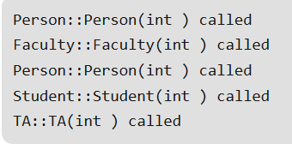
#include<iostream>
using namespace std;
class Person {
public: // Data members of person
Person(int x) { cout << "Person::Person(int ) called" << endl; }
};
class Faculty : public Person {
public: // data members of Faculty
Faculty(int x):Person(x) {
cout<<"Faculty::Faculty(int ) called"<< endl;
}
};
class Student : public Person {
public: // data members of Student
Student(int x):Person(x) {
cout<<"Student::Student(int ) called"<< endl;
}
};
class TA : public Faculty, public Student {
public:
TA(int x):Student(x), Faculty(x) {
cout<<"TA::TA(int ) called"<< endl;
}
};
int main() {
TA ta1(30);
}

Slide 39
In the above program, constructor of ‘Person’ is called two times.
Destructor of ‘Person’ will also be called two times when object ‘ta1’ is destructed.
So object ‘ta1’ has two copies of all members of ‘Person’, this causes ambiguities.
The solution to this problem is ‘virtual’ keyword.
We make the classes ‘Faculty’ and ‘Student’ as virtual base classes to avoid two copies of ‘Person’ in ‘TA’ class.
For example, consider the following program

Slide 40
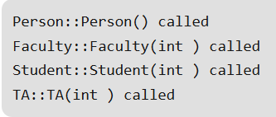
#include<iostream>
using namespace std;
class Person {
public:
Person(int x) { cout << "Person::Person(int ) called" << endl; }
Person() { cout << "Person::Person() called" << endl; }
};
class Faculty : virtual public Person {
public:
Faculty(int x):Person(x) {
cout<<"Faculty::Faculty(int ) called"<< endl;
}
};
class Student : virtual public Person {
public:
Student(int x):Person(x) {
cout<<"Student::Student(int ) called"<< endl;
}
};
class TA : public Faculty, public Student {
public:
TA(int x):Student(x), Faculty(x) {
cout<<"TA::TA(int ) called"<< endl;
}
};
int main() {
TA ta1(30);
}

Slide 41
In the above program, constructor of ‘Person’ is called once.
One important thing to note in the above output is, the default constructor of ‘Person’ is called.
When we use ‘virtual’ keyword, the default constructor of grandparent class is called by default even if the parent classes explicitly call parameterized constructor.
How to call the parameterized constructor of the ‘Person’ class? The constructor has to be called in ‘TA’ class. For example, see the following program

Slide 42
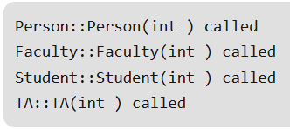
#include<iostream>
using namespace std;
class Person {
public:
Person(int x) { cout << "Person::Person(int ) called" << endl; }
Person() { cout << "Person::Person() called" << endl; }
};
class Faculty : virtual public Person {
public:
Faculty(int x):Person(x) {
cout<<"Faculty::Faculty(int ) called"<< endl;
}
};
class Student : virtual public Person {
public:
Student(int x):Person(x) {
cout<<"Student::Student(int ) called"<< endl;
}
};
In general, it is not allowed to call the grandparent’s constructor directly, it has to be called through parent class.
It is allowed only when ‘virtual’ keyword is used.
class TA : public Faculty, public Student {
public:
TA(int x):Student(x), Faculty(x), Person(x) {
cout<<"TA::TA(int ) called"<< endl;
}
};
int main() {
TA ta1(30);
}

Slide 43
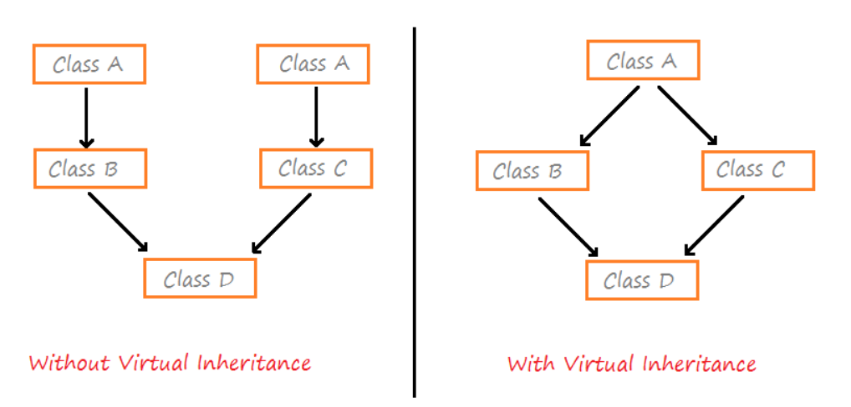
The diamond problem

Slide 44
using namespace std;
class A{
public:
A(){}
void name(){
cout << "This is class A \n";
}
};
class B: public A{
public:
B(){}
};
class C: public A{
public:
C(){}
};
class D: public B, public C{
public:
D(){}
};
int main(){
D d;
d.name();
return 0;
}
4 inheritance are taking place in the above example:
Class B inherits Class A.
Class C inherits Class A.
Class D inherits Class B and Class C

Slide 45
There is no syntactical error in the above program but still, if you try to compile then it will give the following compilation error:
line 35|error: request for member ‘name’ is ambiguous
This is because there are two instances of name() method, one inherited by class B and the other one inherited by class C.
So, the compiler gets confused and is not able to decide which name() method to call?
This ambiguity arose because of the presence of multiple instances of ‘class A’.
Virtual inheritance is a technique in C++ that ensures that only one copy or instance of base class’s member variables is inherited by grandchild derived class.
It means that there will be only one instance of class A i.e B::A and C::A are same, and the same would be inherited and called by D.
To create a virtual inheritance virtual keyword is used.

Slide 46

class A{
public:
A(){}
void name(){
cout << "This is class A \n";
}
};
class B: virtual public A{
public:
B(){}
};
class C: virtual public A{
public:
C(){}
};
class D: public B, public C{
public:
D(){}
};
int main()
{
D d;
d.name();
return 0;
}

Slide 47
Modes of Inheritance
Public mode: If we derive a sub class from a public base class. Then the public member of the base class will become public in the derived class and protected members of the base class will become protected in derived class.
Protected mode: If we derive a sub class from a Protected base class. Then both public member and protected members of the base class will become protected in derived class.
Private mode: If we derive a sub class from a Private base class. Then both public member and protected members of the base class will become Private in derived class.
Note : The private members in the base class cannot be directly accessed in the derived class, while protected members can be directly accessed.

Slide 48
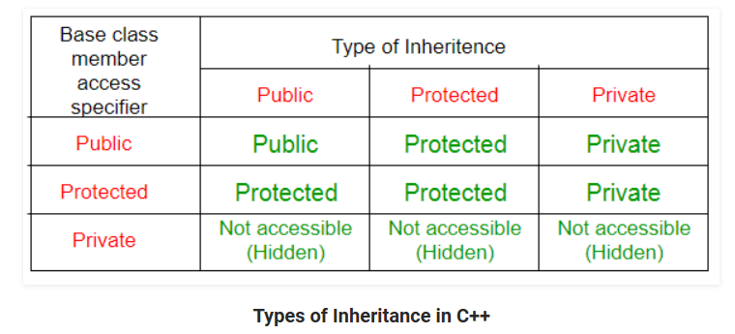

Slide 49
// C++ Implementation to show that a derived class // doesn’t inherit access to private data members. // However, it does inherit a full parent object
class A {
public:
int x;
protected:
int y;
private:
int z;
};
class B : public A {
// x is public // y is protected // z is not accessible from B
};
class C : protected A {
// x is protected // y is protected // z is not accessible from C
};
class D : private A { // 'private' is default for classes
// x is private // y is private // z is not accessible from D
};

Slide 50
class Base {
public:
int a;
protected:
int b;
private:
int c;
};
class Derived_Public : public Base{
/* a is public
b is protected
c is inaccessible */
};
class Derived_Protected : protected Base{
/* a is protected
b is protected
c is inaccessible */
};
class Derived_private : private Base{
/* a is private
b is private
c is inaccessible */
}

Slide 51
class Shape {// Base class Shape
public:
void setWidth(int w) {
width = w;
}
void setHeight(int h) {
height = h;
}
protected:
int width;
int height;
};
class PaintCost {// Base class PaintCost
public:
int getCost(int area) {
return area * 70;
}
};
class Rectangle: public Shape, public PaintCost {// Derived class
public:
int getArea() {
return (width * height);
}
};
ÖR:
int main(void) {
Rectangle Rect;
int area;
Rect.setWidth(5);
Rect.setHeight(7);
area = Rect.getArea();
// Print the area of the object.
cout << "Total area: " << Rect.getArea() << endl;
// Print the total cost of painting
cout << "Total paint cost: $" << Rect.getCost(area) << endl;
return 0;
}

Slide 52
Order of Constructor Call with Inheritance in C++
Base class constructors are always called in the derived class constructors. Whenever you create derived class object, first the base class default constructor is executed and then the derived class's constructor finishes execution.
Whether derived class's default constructor is called or parameterised is called, base class's default constructor is always called inside them.
To call base class's parameterised constructor inside derived class's parameterised constructor, we must mention it explicitly while declaring derived class's parameterized constructor

Slide 53
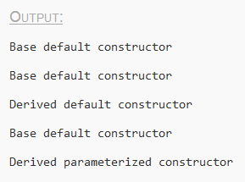
class Base{
int x;
public:
Base() {// default constructor
cout << "Base default constructor\n";
}
};
class Derived : public Base{
int y;
public:
Derived() { // default constructor
cout << "Derived default constructor\n";
}
Derived(int i) { // parameterized constructor
cout << "Derived parameterized constructor\n";
}
};
int main(){
Base b;
Derived d1;
Derived d2(10);
}

Slide 54
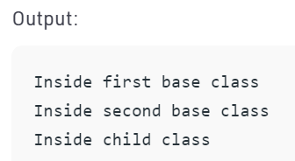
class Parent1 { // first base class
public:
Parent1() { // first base class's Constructor
cout << "Inside first base class" << endl;
}
};
class Parent2 { // second base class
public:
Parent2() { // second base class's Constructor
cout << "Inside second base class" << endl;
}
};
class Child : public Parent1, public Parent2 {
// child class inherits Parent1 and Parent2
public:
Child() { // child class's Constructor
cout << "Inside child class" << endl;
}
};
// main function
int main() {
Child obj1; // creating object of class Child
return 0;
}

Slide 55
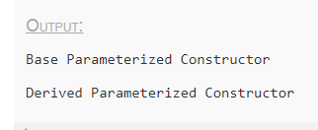
class Base{
int x;
public:
Base(int i) { // parameterized constructor
x = i;
cout << "Base Parameterized Constructor\n";
}
};
class Derived : public Base{
int y;
public:
Derived(int j):Base(j) { // parameterized constructor
y = j;
cout << "Derived Parameterized Constructor\n";
}
};
int main(){
Derived d(10) ;
}
Base class Parameterized Constructor in Derived class Constructor:
We can explicitly mention to call the Base class's parameterized constructor when Derived class's parameterized constructor is called.
Whenever the derived class’s default constructor is called, the base class’s default constructor is called automatically.
To call the parameterised constructor of base class inside the parameterised consructor of sub class, we have to mention it explicitly.
The parameterised constructor of base class cannot be called in default constructor of sub class, it should be called in the parameterised constructor of sub class.

Slide 56
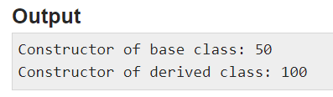
#include <iostream>
using namespace std;
class MyBaseClass {
public:
MyBaseClass(int x) {
cout << "Constructor of base class: " << x << endl;
}
};
class MyDerivedClass : public MyBaseClass { //base constructor as initializer list
public:
MyDerivedClass(int y) : MyBaseClass(50) {
cout << "Constructor of derived class: " << y << endl;
}
};
int main() {
MyDerivedClass derived(100);
}

Slide 57
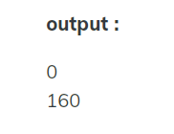
class Rectangle{
private :
float length;
float width;
public:
Rectangle ()
{
length = 0;
width = 0;
}
Rectangle (float len, float wid) {
length = len;
width = wid;
}
float area() {
return length * width ;
}
};
class Box : public Rectangle{
private :
float height;
public:
Box () {
height = 0;
}
Box (float len, float wid, float ht) : Rectangle(len, wid) {
height = ht;
}
float volume() {
return area() * height;
}
};
int main ()
{
Box bx;
Box cx(4,8,5);
cout << bx.volume() << endl;
cout << cx.volume() << endl;
return 0;
}

Slide 58
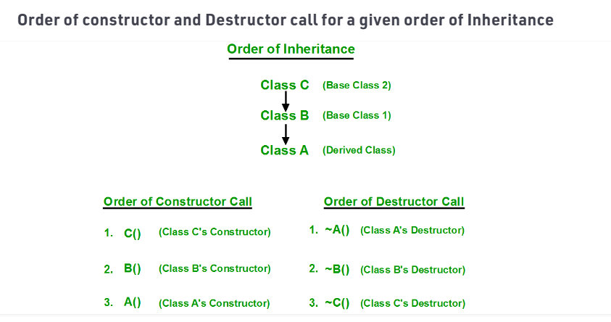

Slide 59
Functions that are never Inherited
Constructors and Destructors are never inherited and hence never overrided.
Also, assignment operator = is never inherited. It can be overloaded but can't be inherited by sub class

Slide 60
Constructor call in Multiple Inheritance in C++
Its almost the same, all the Base class's constructors are called inside derived class's constructor, in the same order in which they are inherited.
class A : public B, public C ;
In this case, first class B constructor will be executed, then class C constructor and then class A constructor.

Slide 61
Polymorphism in C++
The word polymorphism means having many forms.
In simple words, we can define polymorphism as the ability of a message to be displayed in more than one form.
Real life example of polymorphism, a person at the same time can have different characteristic. Like a man at the same time is a father, a husband, an employee. So the same person posses different behavior in different situations. This is called polymorphism.
Polymorphism is considered as one of the important features of Object Oriented Programming.
In C++ polymorphism is mainly divided into two types:
Compile time Polymorphism
Runtime Polymorphism

Slide 62
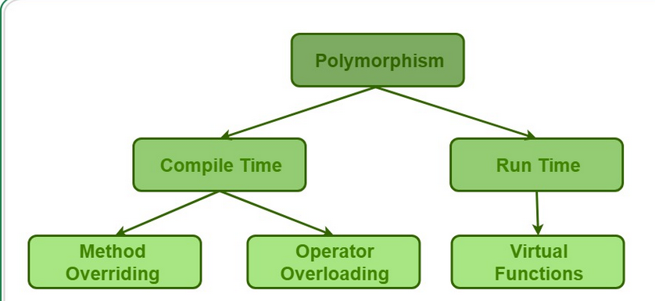

Slide 63
Compile time polymorphism: This type of polymorphism is achieved by function overloading or operator overloading.
Function Overloading: When there are multiple functions with same name but different parameters then these functions are said to be overloaded.
Functions can be overloaded by change in number of arguments or/and change in type of arguments.

Slide 64
#include<iostream> using namespace std;
class Geeks {
public:
void func(int x) { // function with 1 int parameter
cout << "value of x is " << x << endl;
}
void func(double x) { // function with same name but 1 double parameter
cout << "value of x is " << x << endl;
}
void func(int x, int y) { // function with same name and 2 int parameters
cout << "value of x and y is " << x << ", " << y << endl;
}
};
int main() {
Geeks obj1;
obj1.func(7); // Which function is called will depend on the parameters passed
obj1.func(9.132); // The second 'func' is called
obj1.func(85,64); // The third 'func' is called
return 0;
}
// C++ program for function overloading

Slide 65
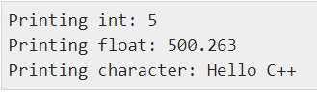
#include <iostream> using namespace std;
class printData {
public:
void print(int i) {
cout << "Printing int: " << i << endl;
}
void print(double f) {
cout << "Printing float: " << f << endl;
}
void print(char* c) {
cout << "Printing character: " << c << endl;
}
};
int main(void) {
printData pd;
pd.print(5); // Call print to print integer
pd.print(500.263); // Call print to print float
pd.print("Hello C++"); // Call print to print character
return 0;
}

Slide 66
using namespace std;
class Sum {
public:
int add(int num1,int num2){
return num1 + num2;
}
int add(int num1, int num2, int num3){
return num1 + num2 + num3;
}
};
int main(void) {
//Object of class Sum
Sum obj;
//This will call the second add function
cout<<obj.add(10, 20, 30)<<endl;
//This will call the first add function
cout<<obj.add(11, 22);
return 0;
}
Derleyici program derlenmeden önce hangi işlevin yürütülür bildiği için derleme zamanı çok biçimliliğidir.

Slide 67
Operatör Aşırı Yükleme: C ayrıca aşırı yük operatörleri için seçenek de sağlar.
Örneğin, dize sınıfı için işleci (' ') iki dizeyi bir araya getirmek için yapabiliriz.
Bunun, görevi iki işlenen eklemek olan ekleme işleci olduğunu biliyoruz.
Bu nedenle, tamsayı işlenenleri arasına yerleştirildiğinde tek bir işleç ' ' ekler ve dize işlenenleri arasına yerleştirildiğinde bunları bir araya getirilir

Slide 68
C 'ta, nesneler veya yapılar gibi kullanıcı tanımlı türler üzerinde çalıştığımız sürece bir işleci aşırı yükleyebiliriz.
Int, double gibi temel türler için operatör aşırı yüklemesini kullanamayız.
İşleç aşırı temelde işlev aşırı, burada farklı işleç işlevleri aynı sembole ancak farklı işlenenlere sahiptir.
Ve işlenenlere bağlı olarak, farklı işleç işlevleri yürütülür.

Slide 69

#include <iostream>
using namespace std;
class OperatorOverload {
private:
int x;
public:
OperatorOverload() : x(10) {}
void operator ++() {
x = x + 2;
}
void Print() {
cout << "The Count is: " << x;
}
};
int main() {
OperatorOverload ov;
++ov;
ov.Print();
return 0;
}

Slide 70

#include<iostream> using namespace std;
class Complex {
private:
int real, imag;
public:
Complex(int r = 0, int i =0) {real = r; imag = i;}
Complex operator + (Complex const &obj) { // This is automatically called when '+' is used with between two Complex objects
Complex res;
res.real = real + obj.real;
res.imag = imag + obj.imag;
return res;
}
void print() { cout << real << " + i" << imag << endl; }
};
int main() {
Complex c1(10, 5), c2(2, 4);
Complex c3 = c1 + c2; // An example call to "operator+"
c3.print();
}
// CPP program to illustrate // Operator Overloading

Slide 71
Operatör işlevleri ile normal fonksiyonlar arasındaki fark nedir?
İşleç işlevleri normal işlevler ile aynıdır.
Tek farklar, bir işleç işlevinin adı her zaman işleç anahtar sözcüğüdür ve karşılık gelen işleç kullanıldığında işleç işlevlerinin sembolü tarafından adlandırılır.
Tüm operatörleri aşırı yükleyebilir miyiz?
Çok azı dışında hemen hemen tüm operatörler aşırı yüklenebilir.
Aşağıda, aşırı yüklenemeyen işleçlerin listesi yer almaktadır.
. (dot)
::
?:
sizeof

Slide 72
#include<iostream> using namespace std;
class Complex {
private:
int real, imag;
public:
Complex(int r = 0, int i =0) {real = r; imag = i;}
void print() { cout << real << " + i" << imag << endl; }
// The global operator function is made friend of this class so // that it can access private members
friend Complex operator + (Complex const &, Complex const &);
};
Complex operator + (Complex const &c1, Complex const &c2)
{
return Complex(c1.real + c2.real, c1.imag + c2.imag);
}
int main() {
Complex c1(10, 5), c2(2, 4);
Complex c3 = c1 + c2; // An example call to "operator+"
c3.print();
return 0;
}

Slide 73
Runtime polymorphism: Bu tür çok biçimlilik, function Overriding.
Function overriding tarafından elde edilir, diğer yandan türetilmiş bir sınıfın temel sınıfın üye işlevlerinden biri için bir tanımı olduğunda oluşur.
Bu temel işlevin geçersiz kılındıği söyleniyor.
C devralmada, türetilmiş sınıflarının yanı sıra temel sınıfta da aynı işleve sahip olabiliriz.
Türetilmiş sınıfın bir nesnesini kullanarak işlevi çağırdığımızda, türetilmiş sınıfın işlevi temel sınıftaki yerine yürütülür.
Bu nedenle, işlevi çağıran nesneye bağlı olarak farklı işlevler yürütülür.Bu, C içinde geçersiz kılma işlevi olarak bilinir

Slide 74
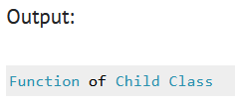
#include <iostream>
using namespace std;
class BaseClass {
public:
void disp(){
cout<<"Function of Parent Class";
}
};
class DerivedClass: public BaseClass{
public:
void disp() {
cout<<"Function of Child Class";
}
};
int main() {
DerivedClass obj = DerivedClass();
obj.disp();
return 0;
}
Function Overriding
Bir işlevi geçersiz kılmak için alt sınıfta aynı imzaya sahip olmanız gerekir.
İmzadan kastım veri türü ve parametre sırası.
Burada üst işlevde herhangi bir parametremiz yok, bu nedenle alt işlevde herhangi bir parametre kullanmadık.

Slide 75

#include <iostream>
using namespace std;
class Mammal {
public:
void eat() {
cout << "Mammals eat...";
}
};
class Cow: public Mammal {
public:
void eat() {
cout << "Cows eat grass...";
}
};
int main(void) {
Cow c = Cow();
c.eat();
return 0;
}

Slide 76
class A {
int a, b, c;
public:
void add(int x, int y) {
a=x;b=y;
cout<<"addition of a+b is:"<<(a+b)<<endl;
}
void add(int x, int y, int z) {
a=x;b=y;c=z;
cout<<"addition of a+b+c is:"<<(a+b+c)<<endl;
}
void print() {
cout<<"Class A's method is running"<<endl;
} };
class B : public A {
public:
void print() {
cout<<"Class B's method is running"<<endl; } };
int main() {
A a1;
//method overloading (Compile-time polymorphism)
a1.add(6, 5);
//method overloading (Compile-time polymorphism)
a1.add(1, 2, 3);
B b1;
//Method overriding (Run-time polymorphism)
b1.print();
}

Slide 77
#include <iostream>
using namespace std;
class Mammal {
public:
void eat() {
cout << "Mammals eat...";
}
};
class Cow: public Mammal {
public:
void eat() {
cout << "Cows eat grass...";
}
};
int main(void) {
Cow c = Cow();
c.eat();
return 0;
}

Slide 78
class A {
int a, b, c;
public:
void add(int x, int y) {
a=x;b=y;
cout<<"addition of a+b is:"<<(a+b)<<endl;
}
void add(int x, int y, int z) {
a=x;b=y;c=z;
cout<<"addition of a+b+c is:"<<(a+b+c)<<endl;
}
void print() {
cout<<"Class A's method is running"<<endl;
} };
class B : public A {
public:
void print() {
cout<<"Class B's method is running"<<endl; } };
int main() {
A a1;
//method overloading (Compile-time polymorphism)
a1.add(6, 5);
//method overloading (Compile-time polymorphism)
a1.add(1, 2, 3);
B b1;
//Method overriding (Run-time polymorphism)
b1.print();
}

Slide 79
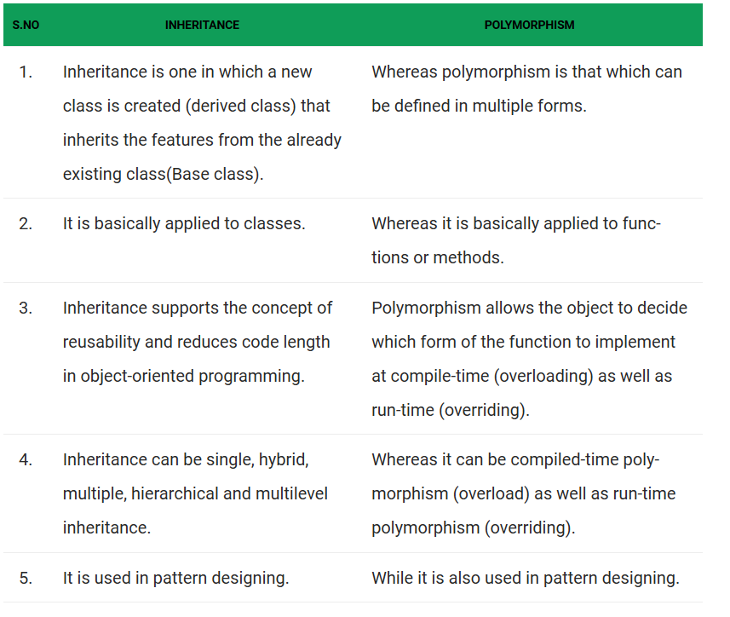

Slide 80
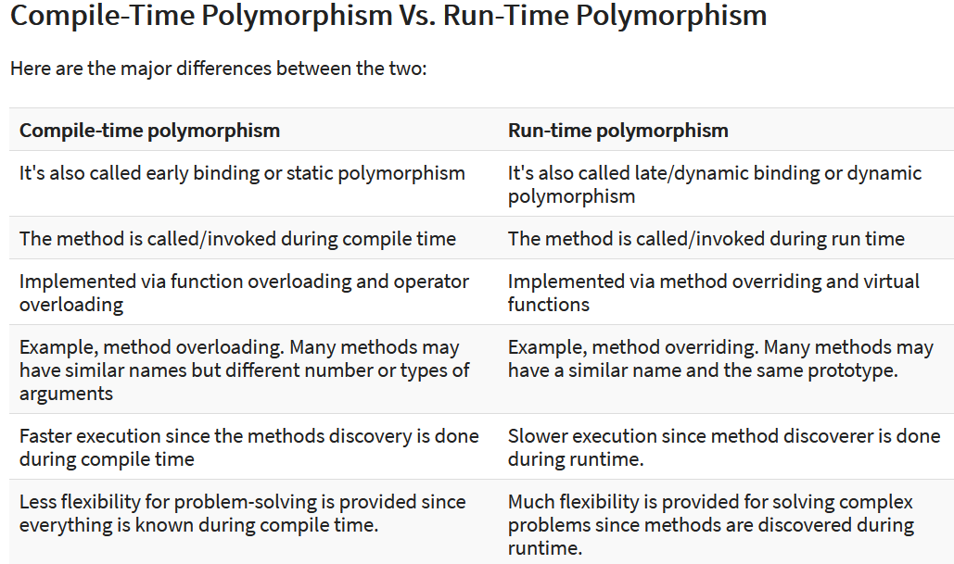

Slide 81
Defining a Pointer of Class type
class Simple{
public:
int a;
};
int main(){
Simple obj;
Simple* ptr; // Pointer of class type
ptr = &obj;
cout << obj.a;
cout << ptr->a; // Accessing member with pointer
}

Slide 82
class Data{
public:
int a;
void print()
{
cout << "a is "<< a;
}
};
int main(){
Data d, *dp;
dp = &d; // pointer to object
int Data::*ptr=&Data::a; // pointer to data member 'a'
d.*ptr=10;
d.print();
dp->*ptr=20;
dp->print();
}
Pointer to Data Members of Class

Slide 83
Pointer to Member Functions of Class
return_type (class_name::*ptr_name) (argument_type) = &class_name::function_name;
class Data{
public:
int f(float)
{
return 1;
}
};
int (Data::*fp1) (float) = &Data::f; // Declaration and assignment
int (Data::*fp2) (float); // Only Declaration
int main(){
fp2 = &Data::f; // Assignment inside main()
}

Slide 84
C++ Virtual Functions
A virtual function is another way of implementing run-time polymorphism in C++.
It is a special function defined in a base class and redefined in the derived class.
virtual functions allow derived classes to provide different versions of a base class function
To declare a virtual function, you should use the virtual keyword.
Using virtual functions in the base class ensures that the function can be overridden in these cases.
Thus, virtual functions actually fall under function overriding.
Virtual Function is a function in base class, which is overrided in the derived class, and which tells the compiler to perform Late Binding on this function.

Slide 85
In other words, defining in a base class a virtual function that has another version in a derived class signals to the compiler, "We don't want static binding for this function. What we do want is the selection of the function to be called at any given point in the program based on the kind of object for which is called."

Slide 86


class Base{
public:
void show() {
cout << "Base class";
}
};
class Derived:public Base{
public:
void show()
{
cout << "Derived Class";
}
}
int main(){
Base* b; //Base class pointer
Derived d; //Derived class object
b = &d;
b->show(); //Early Binding Ocuurs
}
class Base{
public:
virtual void show()
{
cout << "Base class\n";
}
};
class Derived:public Base{
public:
void show()
{
cout << "Derived Class";
}
}
int main(){
Base* b; //Base class pointer
Derived d; //Derived class object
b = &d;
b->show(); //Late Binding Ocuurs
}

Slide 87
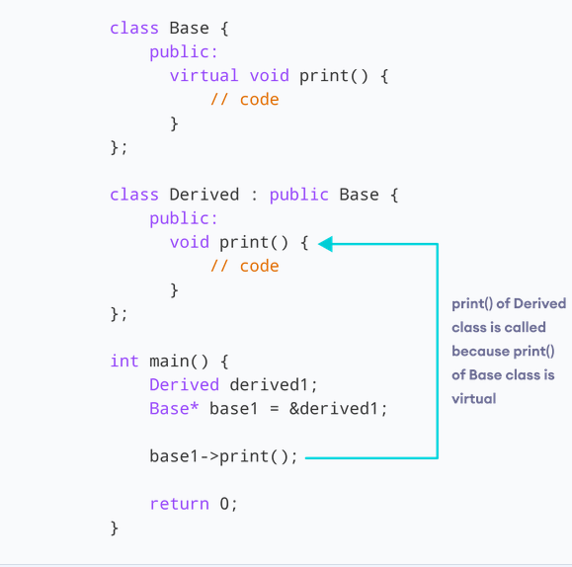

Slide 88
class base {
public:
virtual void print() {
cout << "print base class" << endl;
}
void show() {
cout << "show base class" << endl;
}
};
class derived : public base {
public:
void print() {
cout << "print derived class" << endl;
}
void show() {
cout << "show derived class" << endl;
}
};
int main() {
base* bptr;
derived d;
bptr = &d;
bptr->print(); // virtual function, binded at runtime
bptr->show(); // Non-virtual function, binded at compile time
}
Explanation:
Runtime polymorphism is achieved only through a pointer (or reference) of base class type.
Also, a base class pointer can point to the objects of base class as well as to the objects of derived class.
In above code, base class pointer ‘bptr’ contains the address of object ‘d’ of derived class.
Late binding(Runtime) is done in accordance with the content of pointer (i.e. location pointed to by pointer)
Early binding(Compile time) is done according to the type of pointer, since print() function is declared with virtual keyword so it will be bound at run-time (output is print derived class as pointer is pointing to object of derived class ) and
show() is non-virtual so it will be bound during compile time(output is show base class as pointer is of base type ).

Slide 89
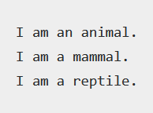
#include <iostream>
using namespace std;
class Animal{
public:
virtual void my_features()
{
cout << "I am an animal.";
}
};
class Mammal : public Animal{
public:
void my_features()
{
cout << "\nI am a mammal.";
}
};
class Reptile : public Animal{
public:
void my_features() {
cout << "\nI am a reptile.";
}
};
//intermediate function
void intermediate_func(Animal *a1){
a1->my_features();
}
Ör:
int main(){
Animal *obj1 = new Animal;
Mammal *obj2 = new Mammal;
Reptile *obj3 = new Reptile;
intermediate_func(obj1);
intermediate_func(obj2);
intermediate_func(obj3);
return 0;
}

Slide 90
// C++ program to demonstrate the use of virtual function
#include <iostream>
#include <string>
using namespace std;
class Animal {
private:
string type;
public:
// constructor to initialize type
Animal() : type("Animal") {}
// declare virtual function
virtual string getType() {
return type;
}
};

Slide 91
class Dog : public Animal {
private:
string type;
public:
Dog() : type("Dog") {} // constructor to initialize type
string getType() override {
return type;
}
};
class Cat : public Animal {
private:
string type;
public:
Cat() : type("Cat") {} // constructor to initialize type
string getType() override {
return type;
}
};

Slide 92
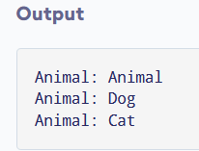
void print(Animal* ani) {
cout << "Animal: " << ani->getType() << endl;
}
int main() {
Animal* animal1 = new Animal();
Animal* dog1 = new Dog();
Animal* cat1 = new Cat();
print(animal1);
print(dog1);
print(cat1);
return 0;
}
Daha sonra şu işaretçileri kullanarak print() işlevini çağırırız:
print(animal1) çağrıldığında, işaretçi bir Animal nesnesine işaret eder.
Bu nedenle, Animal sınıfındaki sanal işlev print() içinde yürütülür.
Print(dog1) çağrıldığında, işaretçi bir Dog nesnesine işaret ediyor.
Bu nedenle, sanal işlev geçersiz kılınmıştır ve Dog işlevi print() içinde yürütülür.
print(cat1) çağrıldığında, işaretçi bir Cat nesnesine işaret ediyor.
Bu nedenle, sanal işlev geçersiz kılınmıştır ve Cat işlevi print() içinde yürütülür.

Slide 93
#include <iostream>
using namespace std;
class ClassA {
public:
virtual void show() {
cout << "The show() function in base class invoked..." << endl;
}
};
class ClassB :public ClassA {
public:
void show() {
cout << "The show() function in derived class invoked...";
}
};
int main() {
ClassA* a;
ClassB b;
a = &b;
a->show();
}

